Slide 1
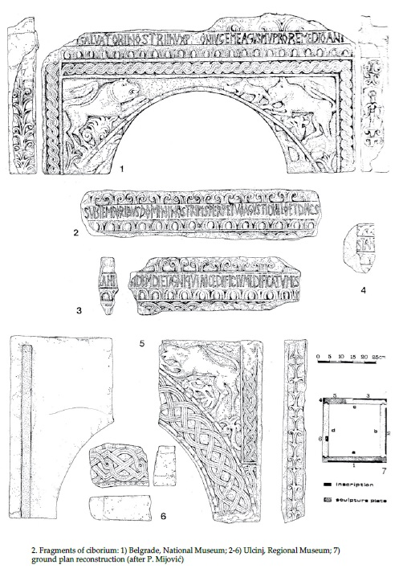
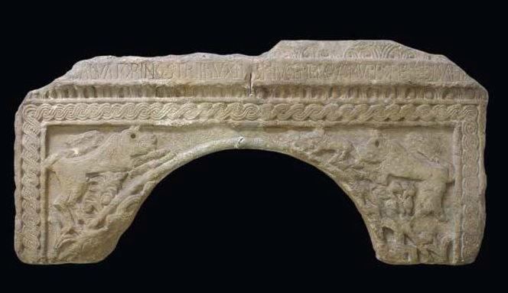
Figs. 1-2: Unknown, Cosmas’ Ciborium from Ulqin, 732-741 A.D., marble, fragments kept in Belgrade, National Museum and Ulcinj, Regional Museum (in Sevovic, 2016).

Slide 2
Fig. 3: Unknown, Cosmas’ Ciborium from Ulqin, 732-741 A.D., marble, fragments kept in Belgrade, National Museum and Ulcinj, Regional Museum (in Sevovic, 2016).
...]I SALVATORI NOSTRI IhV XP[...]CONIVGE MEA GVSMV PRO REMEDIO ANIM[...

Slide 3
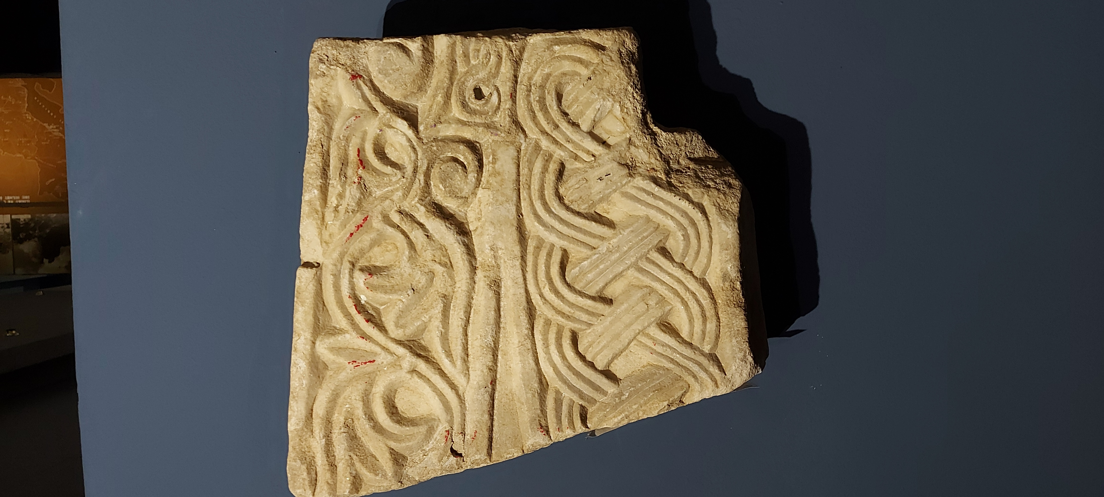
Fig. 4: Unknown, Fragment of a Ciborium from Durrës, 732-741 A.D., marble, kept in Tirana, National Historical Museum.

Slide 4
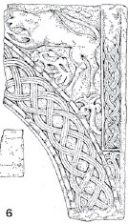
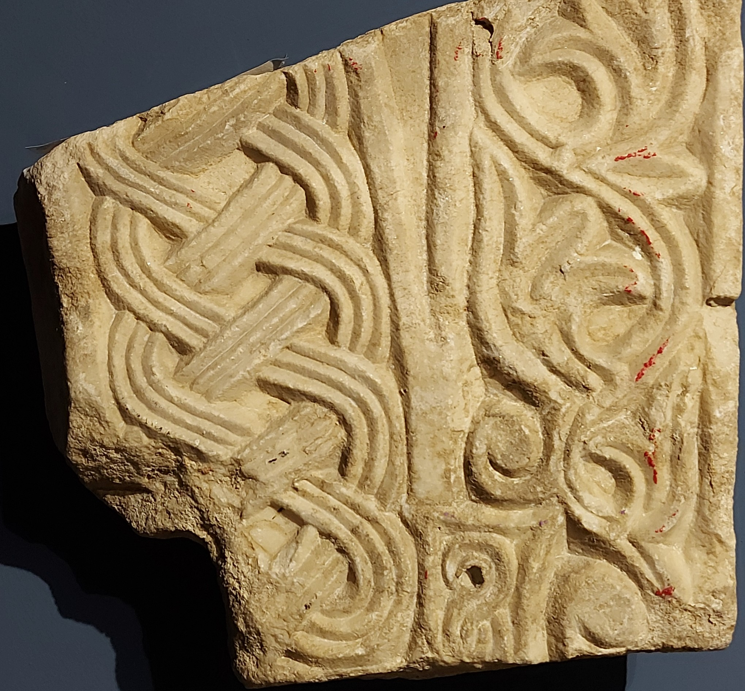
Comparison of the Ulqin & the Durrës Ciboria
Fig. 2 (detail): Unknown, Cosmas’ Ciborium from Ulqin, 732-741 A.D., marble, fragment kept Ulcinj, Regional Museum.
Fig. 4: Unknown, Fragment of a Ciborium from Durrës, 732-741 A.D., marble, kept in Tirana, National Historical Museum.

Slide 5
Fig. 5: Unknown, Ciborium Fragment from the Church of St. Tryphon in Kotor, Montenegro, 802-811 A.D., marble (in Bošković, 1977).

